Slide 1
CS460 Systems for Data Management and Data Science
Query Optimization
Prof. Anastasia Ailamaki
Data-Intensive Applications and Systems (DIAS) Lab
“Man plans, and God laughs” – Yiddish proverb
Some slides adapted from Andy Pavlo

Slide 2
Today’s topic
Data science software stack
Data Processing
Transaction
Management
Graph Data
Pregel, GraphLab, X-Streem, Chaos
Structured Data
Spark SQL
Machine Learning
Gossip Protocols
Query Execution
Batch Data
Map Reduce, Dryad, Spark
Streaming Data
Storm, Naiad, Flink, Spark Streaming Google Data Flow
Consistency protocols
CAP Theorem
Data Storage
Storage Hierarchies & Layouts
Distributed File Systems
(GFS)
NoSQL DB
Dynamo
Big Table Cassandra
Distributed Messging systems
Kafka
Distributed/Decentralized systems
Ressource Management & Optimization
Query optimization
Scheduling (Mesos, YARN)
Notes:
With Orange, we denote more general topics that are applied across several systems and architectures, both in scale-up and scale-out deployments.

Slide 3

Today’s overview
Query Optimization How to improve performance by wisely choosing the order and implementation of the operators?

Slide 4
Outline
Introduction to query optimization
Relational algebra equivalences
Optimizers based on heuristics – INGRES
Optimizers based on heuristics & cost - SYSTEM R
Cost & selectivity estimation
Principle of optimality
System R

Slide 5
Query Optimization
For a given query, find the execution plan with the lowest “cost”.
SELECT S.sname FROM S, T, C WHERE S.sid=T.sid AND T.cid=C.cid AND C.cname=’CS101’
Notes:
SQL is a declarative language which essentially specifies the end objectives without specifying the means to achieve the objective. The database engines, incorporate a component called query optimizer which tries to find the least cost execution plan to process the input query. Plan is defined as a tree of operators to process the data, and cost is a measure of query response time. Essentially, the job of query optimizer is to find a plan which returns results in the lowest time.
Consider the example query which lists the student names registered to CS101 course. There could be different plans for a query with different performance - two of them can be seen here. The left plan joins table C with table T first, and then joins with table S. In the second plan, table S is joined with table T, and then with table C. Note that each of these semantically equivalent plans produces the same end results but perhaps with different execution times.

Slide 6
Query Optimization
The part of a DBMS that is the hardest to implement correctly.
This is (mostly) what you pay for!
No optimizer truly produces the “optimal” plan
Too expensive to consider all plans (NP-complete)!
Impossible to get the accurate cost of a plan without executing it!
Optimizers make a huge difference in terms of
Performance
Scalability
Database capabilities
Notes:
The query optimizer is the hardest component in the database engine to get it right. Many researchers have worked on the problem of query optimization to get the optimal plan but no optimizer can produce it – in fact that is the component we pay for.
Why is hard for the optimizer to produce the “optimal” plan?
This is because the total number of equivalent plans are exponential in the number of relations. The optimizer costs each of these alternate plans and picks the cheapest plan. But it is impossible to get an accurate cost of a plan (without executing it).
Optimizers can make a huge difference on the performance due to the choice of the plan. For instance, in terms of resource usage, one join algorithm requires more memory than the other, while other uses more CPU.
Optimizers plan choice also becomes more important as the data scales. These days, not just the data, even the size of the queries are increasing – for instance, the queries containing 100s of relations are getting more common.
Finally, the database needs to support more complex data format, and cope with evolving hardware. All these affect the query optimizer.

Slide 7
Decisions, decisions…
In what order to execute operations?
Particularly: relative order of joins
Which implementation is best for each operation?
E.g., hash joins, nested loop joins, sort-merge joins…
Which access methods to use?
E.g., scan, use of an index
Suboptimal decisions can have a huge impact! E.g.
Use of one join algorithm vs another
Pushing down selections (that make indexes useless)
Notes:
As we saw earlier, the two different plans had different join orders – essentially specifying order in which the joins are performed in the query. The number of such join orders depends on the join-graph. For instance in the star join, the number of join orders are n! (n factorial).
Even after the join order is decided, still there are choices that need to be made. There are different implementations for each join like hash join, NL, sort-merge join. Further, even for access methods there are choices like sequential scan, index scan, or bitmap scan.
Bad decision can have huge impact. For instance, if we use a hash join in case of less memory can be lead to very bad performance. Also, generally optimizers push down selections for performance. But again, is not always a good idea as sometimes they will prohibit us to use index-lookup join algorithms

Slide 8
Input/output of query optimizer
Input: An Abstract Syntax Tree (AST) representing an SQL query
SELECT S.sname FROM Supplier S, Supply U WHERE S.scity='Seattle' AND S.sstate='WA’ AND S.sno = U.sno AND U.pno = 2
Output: A full physical plan which is translatable to code
Physical plan
Logical plan (extracted from AST)
Notes:
Input to the query optimizer is an abstract syntax tree representing the input query. The AST is built from the query by parsing it. Consider, the example query which lists the name of all suppliers supplying part no. = 2 from Seattle.
The tree structed diagram on the left corresponds to the logical plan, which essentially captures the sequence of operations like join, filter, where, groupBy, etc. applied on the data to output it. Here, we see the following sequence of operations applied: join between Supplier and Supply tables, then the two filters, and finally the projection.
From the logical plan, a physical plan can be generated. In a physical plan, a specific execution strategy is decided for each operator. Like either hash, NL or Sort merge for joins. Similarly decision need to be made on an access path for each table. The decision is based on several aspects such as volume of data being processed by an operation, or desired output format such as sorted manner. For better plans, these decisions need to be taken holistically, and not at each operation level. Not always there is a 1:1 mapping from logical to physical plans.

Slide 9
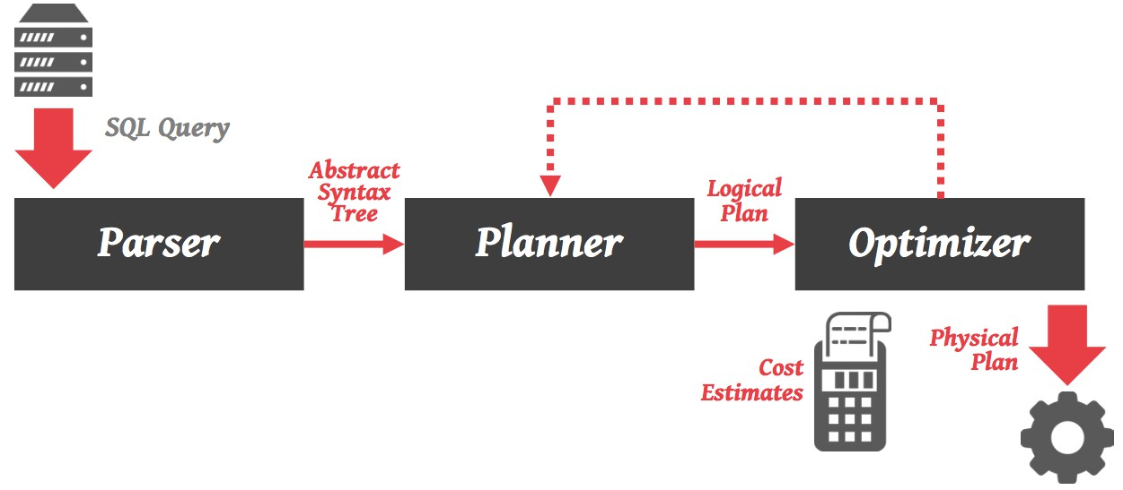

Classic architecture
Optimizer
SQL Query
Cost
estimates
Parser
AST
Logical
Plan
Physical
Plan
Notes:
Query arrives from an external application (or a user). It enters into the parser. The parser (e.g., something build by using yacc) will extract an abstract syntax tree.
This AST will be pushed into the optimizer, to extract one or more logical query plans. These plans will then be converted to physical plans, which will describe exactly when and how each operator will be executed. Physical plans are decided based on cost estimates for each operator. This optimization and generation of the logical plan may even lead to a feedback phase (a back-and-forth between the logical and physical plan), until a good physical plan is produced. Then, the optimizer will push the best plan (with the minimum cost) to the query engine for actual execution.

Slide 10
Classic architecture – Task-oriented
Notes:
For completeness: in terms of internal components, some papers and books split the optimizer into two sub-components. The first one is the planner, which will produce the logical plan, and the second one is the optimizer, which will construct the physical plan. In practice, the boundaries between the planner and the optimizer are rather artificial. For instance, one of the widely used plan selection algorithm is a dynamic programming based plan search. Here, the physical plan is built bottom up deciding on both the logical and corresponding physical operator at each step.

Slide 11
Outline
Introduction to query optimization
Relational algebra equivalences
Optimizers based on heuristics – INGRES
Optimizers based on heuristics & cost - SYSTEM R
Cost & selectivity estimation
Principle of optimality
System R
Multi-query optimization

Slide 12

Relational Algebra Equivalences
Key concept in optimization: Equivalences
Two relational algebra expressions are said to be equivalent if on every legal database instance, the two expressions generate the same set of tuples.
All roads lead to Rome. But some of them are more efficient!
Notes:
Query optimization is based on the key concept of equivalences. As mentioned, there are several equivalent plans to process a query, all outputting the same set of results. For every plan, there exist a corresponding relational expression. These plans are equivalent, if the underlying relational expression is equivalent, i.e., they generate the same set of tuples on every legal database instance.

Slide 13
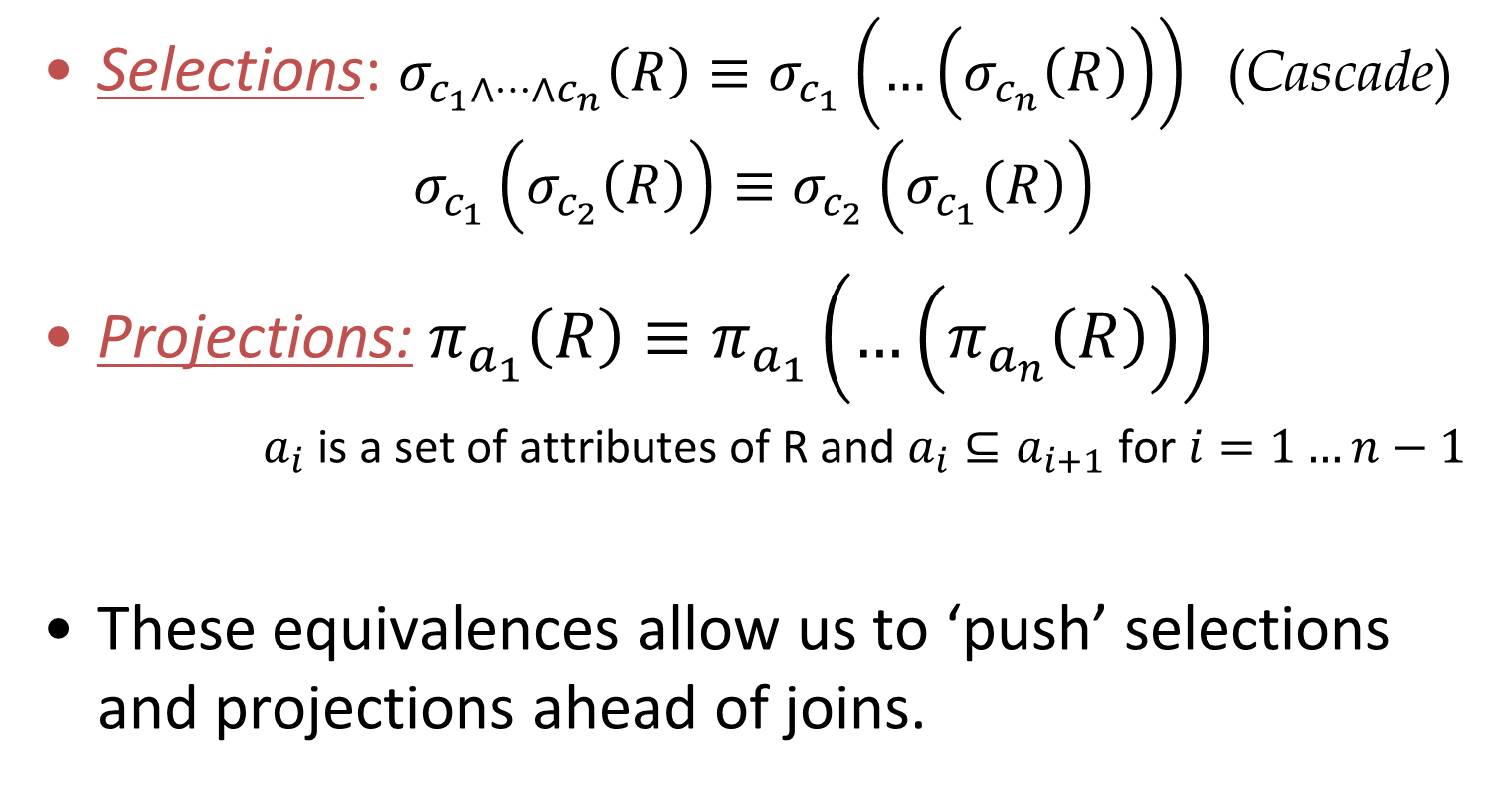
Relational Algebra Equivalences
(Commute)
(Cascade)
Notes:
Let us see some rules of equivalence starting with selections:
Cascade: We can nest selections, i.e., we can split up a conjunctive condition into multiple steps. Here we see that there are n conjunctive conditions, each of them can be applied successively without changing the result set.
Commute: Similarly, we can change the order of selections. This rule is like commutativity in addition and multiplication, wherein the result set is independent of the order of applying the selection conditions.
Coming to Projections: applying a sequence of projections in the super set to subset order is same as applying the single smallest subset (or the last projection). In other words, we can project out the unwanted columns early. This is called as the cascade rule.

Slide 14
Examples …
σ_{age=18 & rating>5} (Sailors)
↔ σ_{age=18} (σ_{rating>5} (Sailors))
↔ σ_{rating>5} (σ_{age=18} (Sailors))
π_{age,rating} (Sailors) ↔ π_{age} (π_{rating} (Sailors)) (??)
π_{age,rating} (Sailors) ↔ π_{age,rating} (π_{age,rating,sid} (Sailors))
Notes:
In the above example, for the selections, the conjunctive predicate on age and rating can be applied successively in two different ways. The order of selections could play an important role wrt performance.
1) Consider the following scenario that age=18 is very selective, and an index exists on it. Further, if rating>5 is not that selective, then it’s cheaper to apply the age predicate first and then the rating predicate. This is because we can use the index to prune a lot the tuples early and with lesser cost, compared to the other scenario. Good rule of thumb is to apply selections in the increase order of selectivities.
2) But the commute property does not work for projections because, in the right-hand side, age does not pass from the inner projection.
3) We see an example wherein the cascade property being satisfied for the projection. We know that <age, rating> is a subset of <age, rating, sid>, and hence it is equivalent to applying projection on <age, rating> only, rather than on <age, rating, sid>.

Slide 15
Another Equivalence
A projection commutes with a selection that only uses attributes retained by the projection
π_{age, rating, sid} (σ_{age<18 & rating>5} (Sailors))
↔ σ_{age<18 & rating>5} (π_{age, rating, sid} (Sailors))
Notes:
11
Until now we have equivalence primarily within the same type of operation. Now lets see a rule which commute between projection and selection. It can commute when selection attributes is a subset of the attributes in projection. Again the more selective operation should be done first. It is useful to do the projection first if there are too many attributes and filter predicates are not selective. This is useful because it can drastically reduce memory requirements because of projection.

Slide 16
Equivalences Involving Joins
These equivalences allow us to choose different join orders.
R ⨝ (S ⨝ T) (R ⨝ S) ⨝ T
(Associative)
(R ⨝ S) (S ⨝ R)
(Commutative)
Notes:
10
Now let us discuss the rule of equivalence for join operator. The first one is the associativity rule which says that, if there are three relations, A, B and C. Then, there are following two ways of joining the three relations producing the same answer: (a) joining S and T first, and then join with R, or (b) joining R and S first, and then join with T. We can choose (b) over (a), if R join S produces much less tuples compared to S join T.
The second rule of equivalence is that it is commutative for most join operators. The inner and full outer join is commutative, but left outer, right outer, and non-equi join is not commutative. For performance, in the some join algorithms, it is important to decide which is the outer and which is the inner relation.

Slide 17
Mixing Joins with Selections & Projections
Converting selection + cross-product to join
Selection on just attributes of S commutes with R S
We can also “push down” projections
σ_{S.sid = R.sid} (Sailors x Reserves)
↔ Sailors _{S.sid = R.sid} Reserves
σ_{S.age<18} (Sailors _{S.sid = R.sid} Reserves)
↔ (σ_{S.age<18} (Sailors)) _{S.sid = R.sid} Reserves
CAREFUL!
Not always wise
π_{S.sname} (Sailors _{S.sid = R.sid} Reserves)
↔ π_{S.sname} (π_{sname,sid}(Sailors) _{S.sid = R.sid} π_{sid}(Reserves))
Notes:
11
Which query does the first expression represent? Ans: SELECT FROM R,S WHERE R.sid=S.sid. If the optimizer didn’t have this equivalence it would require to execute a cross product! and then filter the tuples. But cross product is very expensive.
Pushing the selection before the joins is generally recommended to reduce the number of intermediary results.
Removing as many attributes as possible before join through projection is desirable. However, need to keep sid in the projection, otherwise join will not be defined!
For (2), is it possible that pushing selection inside join is BAD for performance (i.e., the right-hand equivalent is worse)? What would happen if, e.g., I had two indexes on sailors, one on sid and another on age. If I push the selection below the join, then I cannot use the index on sid for the join i.e. cannot use index-based join algorithms. Instead, I could just keep the selection outside the join.

Slide 18
Example – naïve approach
S: 16000 tuples = 320 pages T: 256000 tuples = 5120 pages C: 1600 tuples = 32 pages
25% of courses being taken (T) are ‘cs101’
Tuple-by-tuple takes > 20.8 years
Page-by-page takes 1.5 hours
SELECT S.sname FROM S, T, C WHERE S.sid=T.sid AND T.cid=C.cid AND C.cname=’CS101’
Using cross products
for each tuple c of C on disk do for each tuple s of S on disk do
for each tuple t of T on disk do if the condition on (s, t, c) holds
output s.sname;
Notes:
Let us the see the impact of the equivalence discussed using an example with simple 3-way join and a filter predicate.
S: students
T: takes
C: courses
Let us see a Naïve approach first, which essentially does a cross product of the three relations using nested loop join algorithm, and then apply the filter predicate, and finally the projection operator. Assuming all the tables are on a SSD, the algorithm is to fetch each tuple from C, S and T in a loop from the SSD, and then apply selection and projection.
Assume avg time to fetch a page 0.1 ms
Assume each relation has 5 attributes
Assume 50 tuples/page
Assume that S join T on sid results each tuple of S matches with 16 tuples of T (i.e., full relation)
Assume that C join T on sid results each tuple of C matches with 160 tuples of T (i.e., full relation)
Assume projections happen in a pipelined fashion
S: 16000 tuples -> 320 pages
T: 256000 tuples -> 5120 pages
C: 1600 tuples -> 32 pages
-> Super-Worst scenario:
The cartesian product of fetching a page for each tuple
#tuples(C) * #tuples(S) * #tuples(T) = 1’600 * 16’000 * 256’000 = 6’553’600’000’000 I/Os
6553600000000*0.1ms = 20.8 years
-> Very-Bad scenario (better than before):
Now lets consider a better scenario, wherein still the cartesian product happens, but reading pages at a time not tuples. This reduces the time to 36 hrs.
#pages(C) * #pages(S) * #pages(T) = 32 * 320 * 5120 = 52428800 I/Os
52428800 * 0.1ms = 1.5 hours

Slide 19
Explanation
Assume relations are stored on an SSD
Each I/O to fetch a page is 0.1ms
→ Super-Worst scenario / tuple-by-tuple
Cartesian product of fetching a page for each tuple (1 I/O per tuple):
#tuples(C) * #tuples(S) * #tuples(T) = 1,600 * 16,000 * 256,000 = 6,553,600,000,000 I/Os. At 0.1ms per I/O ➔ query takes 20.8 years
→ Not-Worst-But-Very-Bad scenario (page by page):
Cartesian product reading pages at a time, not tuples (1 I/O per page) #pages(C) * #pages(S) * #pages(T) = 32 * 320 * 5120 = 52,428,800 I/Os
52,428,800 * 0.1ms = 5,242 s ➔ query takes 1.5 hours
Notes:
Note, we exclude the pages for writing the outputs on this slide

Slide 20
Example – educated approach
S: 16000 tuples = 320 pages T: 256000 tuples = 5120 pages C: 1600 tuples = 32 pages
Use joins instead of cross product & push down projection 17 sec
SELECT S.sname FROM S, T, C WHERE S.sid=T.sid AND T.cid=C.cid AND C.cname=’CS101’
Notes:
Assume avg time to fetch a page 0.1 ms
Assume each relation has 5 attributes
Assume 50 tuples/page
Assume that S join T on sid results each tuple of S matches with on avg 16 tuples of T (i.e., full relation as each student takes multiple courses)
Let's assume that 25% of tuples of T match with a filtered tuple of C, i.e 25% of enrollments are in cname=‘CS101’
Assume projections happen in a pipelined fashion
Let us now see a better algorithm which uses an equivalence rule between selections and joins. Now two more optimizations: a) using Block Nested Loops wherein a block of pages are fetched a time for each relation and then joined, and (b) pushing down projections:
The result of both the optimization results in reducing the running time to 17 sec, as described in detail below.
Block nested loop join cost = #pages(Outer) + #pages(Inner)*#pages(Outer)/BlockSize
CostJoinS-T = 320 + (5120*320)/10 = 164,160 I/Os
JoinResultS-T = 256,000 tuples with 10 attributes (25 tuples/page) = 10,240 pages
Project (pick 2 out of the 10 attributes) 2/10*JoinResultS-T = 1/5 * 10240 = 2,048 pages
Cost(JoinResultS-T)-C = 32* ceil(2048/10) = 6560 IOs
Total: CostJoinS-T +Cost(JoinResultS-T)-C = 170,720 I/Os
170,720*I/O cost = 170720*0.1 ⋍ 17 sec

Slide 21
Example – educated approach (cont’d)
Node | output #tps/pg | output #tps | output #pgs | I/O pgs
S | 50 | 16000 | 320 | 320
T | 50 | 256000 | 5120 | 0
S⋈T | 25 | 256000 | 10240 | 163840
π(ST) | 125 | 256000 | 2048 | 0
C | 50 | 1600 | 32 | 0
ST ⋈ C | 36 | 64000 | 1778 | 6560
π(STC) | 250 | 64000 | 256 | 0
Notes:
Starting from the left-most part of the plan tree, the engine will scan S, using 10 buffers ([10b]), as part of the outer loop of BNL.
T on the other hand, will be read as part of the BNL, and thus we assign 0 I/O pgs on the scan entry and count it in the join below.
The BNL S⋈T will have an I/O cost of: |S| + |S|/10 * |T| = 164,160 I/Os. |S| is already counted in the first row, thus for the join we mark 163840 I/Os. This is an FK join on unfiltered tables, so assume no NULLs, there the output is as big as the table containing the FK (table T).
The projection happens in a pipelined fashion, so it will not introduce any IO and its output will be saved on the 10 (in-memory) buffers of the top BNL (assuming pull-based execution, in which case we refill the buffers by continuing on the bottom join every time we need more data). The projection drops all but 2 attributes =(equi-sized attributes)=> 25 * 10/2 tps/pg and there are ceil(256000/125)=2048 pgs. Scanning C happens as part of the top BNL, so we do not scan it separately, but only for the last row of the filled table Like the previous BNL, the BNL ST⋈C will scan the inner table (C) as many times as the iterations of the outer loop: ceil(2048/10)=205 iterations. The filter on cname in this example occurs in the join, it is not pushed down. Thus, we will do 205*32 pg I/Os to read C. The output has 7 attributes, so ceil (50 / 7/5) = 36 tuples per page.
Recall the assumption that 25% of tuples of T match with a filtered tuple of C, i.e 25% of enrollments are in CS101, so 64000 output tuples
The final projection also happens in a pipeline manner, so it does not add IO cost to load its inputs

Slide 22
Example – educated approach (cont’d)
Outer Loop Scan (Table S)
I/O Cost: |S| = 320 pages
First BNL Join (S ⋈ T)
I/O Cost: |S|/10 * |T| = 163,840 pages (+ |S| counted already above)
Output: Size of FK table T (256,000 tuples, 10 attributes, 10240 pages)
Intermediate Projection
Pipelined operation (no additional I/O)
Reduces from 10 to 2 attributes. Output: 2,048 pages (125 tuples/page)
Second BNL Join ((S ⋈ T) ⋈ C)
Outer relation requires 205 iterations ceil(2,048/10)
I/O Cost: 205 * |C| = 205 * 32 = 6,560 pages
64000 tuples (assumption 25% of T⋈C is ‘CS101’), 7 attributes. Output 1778 pages (36 tuples/page)
Final Projection (pipelined again)
Reduces from 7 to 1 attribute: 256 output pages (250 tuples/page)
Total I/O Cost: 320 + 163,840 + 6,560 = 170,720 pages
Notes:
Starting from the left-most part of the plan tree, the engine will scan S, using 10 buffers ([10b]), as part of the outer loop of BNL.
T on the other hand, will be read as part of the BNL, and thus we assign 0 I/O pgs on the scan entry and count it in the join below.
The BNL S⋈T will have an I/O cost of: |S| + |S|/10 * |T| = 164,160 I/Os. |S| is already counted in the first row, thus for the join we mark 163840 I/Os. This is an FK join on unfiltered tables, so assume no NULLs, there the output is as big as the table containing the FK (table T).
The projection happens in a pipelined fashion, so it will not introduce any IO and its output will be saved on the 10 (in-memory) buffers of the top BNL (assuming pull-based execution, in which case we refill the buffers by continuing on the bottom join every time we need more data). The projection drops all but 2 attributes =(equi-sized attributes)=> 25 * 10/2 tps/pg and there are ceil(256000/125)=2048 pgs. Scanning C happens as part of the top BNL, so we do not scan it separately, but only for the last row of the filled table Like the previous BNL, the BNL ST⋈C will scan the inner table (C) as many times as the iterations of the outer loop: ceil(2048/10)=205 iterations. The filter on cname in this example occurs in the join, it is not pushed down. Thus, we will do 205*32 pg I/Os to read C.
The final projection also happens in a pipeline manner, so it does not add IO cost to load its inputs

Slide 23
Example – super optimized
S: 16000 tuples = 320 pages T: 256000 tuples = 5120 pages C: 1600 tuples = 32 pages
Push down selection and reorder joins 1 sec!
SELECT S.sname FROM S, T, C WHERE S.sid=T.sid AND T.cid=C.cid AND C.cname=’CS101’
Notes:
Even better if we push selection below join, because then we can reduce the input of the very first join itself and thus reduce all intermediary results! Further reordering the joins gives a lot of performance benefits in this case.
Here, if we join the filtered C and T first, instead of S and T in the earlier case, we would get just 64K intermediate tuples instead of 256K in the earlier case. This reduces the number of tuples to be processed for the subsequent joins, and thus reducing the overall cost.
Below gives the math behind it:
Assume avg to fetch a page 0.1 ms
Assume each relation has 5 attributes
Assume 50 tuples/page
Assume that S join T on sid results each tuple of S matches with avg 16 tuples of T (i.e., full relation)
Assume that C join T on cid results each tuple of C matches with avg 160 tuples of T (i.e., full relation)
Assume projections happen in a pipelined fashion
-> Push down selection & re-order joins
assume selectivity of C.cname='CS101' is just 1 tuple
CostSelectC = #pages(C) = 32 pages
ResultSelectC = 1 tuple for ‘cs101’ = 1 page (1 tuple of 5 attributes)
ResultProjectC = 0.2*ResultSelectC = 1 page (1 tuple of 1 attribute)
JoinCostC-T = ceil(1/10)*5120 = 5120 I/Os
Let's assume that 25% of tuples of T match with a tuple of C (i.e 25% of T is ‘cs101’)
ResultJoinC-T = 0.25*256000 = 64000 tuples (42 tuples/page) = 1524 pages
ResultProjectRes = 64000/250 = 256 pages
JoinCostResult-S = ceil(256/10)*320 = 8320 I/Os
Total: CostSelectC + JoinCostC-T + JoinCostResult-S = 13472 I/Os
8736*0.1ms ⋍ 0.9sec

Slide 24
An example – super optimized (cont’d)
Node | output #tps/pg | output #tps | output #pgs | I/O pgs
C | 50 | 1600 | 32 | 32
π(σ(C)) | 250 | 1 | 1 | 0
T | 50 | 256000 | 5120 | 0
C⋈T | 42 | 64000 | 1524 | ⌈¹/₁₀⌉*5120
π(CT) | 250 | 64000 | 256 | 0
S | 50 | 16000 | 320 | 0
CT ⋈ S | 42 | 64000 | 1524 | 8320
π(CTS) | 250 | 64000 | 256 | 0
Notes:
Scanning C takes 32 IOs.
Projection and filtering happen in a pipeline fashion; thus, they introduce no IO. 1 course => output = 1 tuple
π(σ(C)) => 1/5 tuple size => 250 tps/pg
C⋈T has 1 attribute from C and 5 from T = 42tps/pg, outer loops = ceil(1 input pg/10buffers) = 1, inner IO cost per outer iteration: 5120. Total: ceil(1/10) * 5120 IOs.
π(CT) => pipelines, so no IO. Prunes 1/(1 + 5) attributes, all equi-sized => #tuples/pg = 250. #pgs = ceil(64000/250) = 256pgs. CT⋈S has 1 attribute from CT and 5 from S = 42tps/pg, outer loops = ceil(256 input pg/10buffers) = 26, inner IO cost per outer iteration: 320 IOs. Total: ceil(256/10) * 320 IOs.

Slide 25
An example – super optimized (cont’d)
Initial Scan (Table C). I/O Cost: |C| = 32 pages
Filter and Projection on C. (pipelined, so no additional I/O)
1 course: 1,600 tuples → 1 tuple. Project keeps 1 attribute. Output: 1 page
First BNL Join (C ⋈ T)
Outer relation requires 1 (ceil(1/10)) iteration
I/O Cost: 1 * |T| = 1 * 5,120 = 5,120 pages
Output: 64,000 tuples, six attributes (1 from C, 5 from T), 1524 pages
Projection on (C ⋈ T). (pipelined again)
Output: 64,000 tuples, one attribute, 256 pages
Second BNL Join ((C ⋈ T) ⋈ S)
Outer relation requires 26 (ceil(256/10)) iterations
I/O Cost: 26 * |S| = 26 * 320 = 8,320 pages
Output: 64000 tuples, 6 attributes (1 from (C⋈T), 5 from S)
Final Projection (pipelined again)
Reduces from 6 to 1 attribute: 256 output pages (250 tuples/page)
Total I/O Cost: 32 + 5,120 + 8,320 = 13,472 pages

Slide 26

Simple queries, straightforward plan
Query planning for OLTP queries is easy because they are sargable → It is usually just picking the best index → Joins are almost always on foreign key relationships with a small cardinality → Can be implemented with simple heuristics
We focus on OLAP queries (more interesting)
Search Argument Able
Pat Selinger
IBM Fellow,
Paradata,
Salesforce
Notes:
Until now we have seen the case of how to optimize OLAP or read only queries, where in there is huge search space to select the best plan. In case of OLTP queries, the are easy since it is sargable. `SARG’ stands for Search ARGument, and it means that the predicate can be executed using an index seek. The idea is to see all the available indexes and pick the best one for the query. For instance, if we want to update the salary of experienced employees, then go through the index of experience column and pick tuples satisfying the predicate, and then update them.

Slide 27
Outline
Introduction to query optimization
Relational algebra equivalences
Optimizers based on heuristics – INGRES
Optimizers based on heuristics & cost - SYSTEM R
Cost & selectivity estimation
Principle of optimality
Notes:
We know there is a very large search space of plans. An important constraint here is that the best plan need to found very quickly. This is typically few 10s of milliseconds. Historically, ORACLE + INGRES in the 70s, employed heuristics to prune the search space. This pruning was done using some of the equivalent rules that we discussed. The advantage of it is that it is very fast but may produce truly optimal plans. On the other hand a purely cost based search produces the optimal plan but takes a lot more time.
There are of course more optimization approaches than the heuristic & heuristic+cost-based ones that we will see today, such as: Randomized Algorithms
Stratified Search
Unified Search
But we will focus in the more popular & traditional ones. Let’s start with heuristic optimization

Slide 28

Heuristic-based optimization
Define static rules that transform logical operators to a physical plan
→ Perform most restrictive selections early → Perform all selections before joins → Predicate/Limit/Projection pushdowns → Join ordering based on cardinality
Example: INGRES and Oracle (until mid 1990s)
Michael Stonebraker,
Turing Award 2014
Notes:
One of the most common optimization strategies is to use heuristics.
Heuristics are rules that transform the query plan to improve performance.
Usually heuristics encode empirical knowledge on query optimization and shape query plans accordingly.
For example, a very frequent rule is to perform most restrictive selections first. This way subsequent operators deal with fewer data and therefore take less time to process.
Another common rule is to perform selections before joins because joins in most cases are more expensive.
In the same spirit, predicates, projections and limit clauses are pushed towards the bottom of the plan to reduce the number of tuples in the upper parts.
Finally, we can order joins based on cardinality, expecting that this will cause fewer intermediate tuples to be generated.
There is no cost based optimization on this. These rules are always applied.
The optimizer consists of the set of all heuristics. Such optimizers were used in Stonrbraker’s first system INGRES at Berkeley and Oracle. Surprisingly Oracle kept the heuristic based optimizer until mid 1990s!!

Slide 29
Example - INGRES
Developed at UC Berkeley. This ultimately led to Ingres Corp., Sybase, MS SQL Server, Britton-Lee, Wang's PACE.
APPEARS
ARTIST_ID | ALBUM_ID
FK | FK
ARTIST
ALBUM
ID | NAME
Integer, PK | VARCHAR(32)
ID | NAME
Integer, PK | VARCHAR(32) UNIQUE
Notes:
Assume a simple database with 3 tables Artist, Appears, Album, where Artist appears in Albums.

Slide 30
INGRES optimizer
Retrieve the names of artists that appear on Joy's mixtape
SELECT ARTIST.NAME FROM ARTIST, APPEARS, ALBUM
WHERE ARTIST.ID=APPEARS.ARTIST_ID AND APPEARS.ALBUM_ID=ALBUM.ID AND ALBUM.NAME=“Joy's Slag Remix”
APPEARS
ARTIST_ID | ALBUM_ID
FK | FK
ARTIST
ID | NAME
Integer, PK | VARCHAR(32)
ALBUM
ID | NAME
Integer, PK | VARCHAR(32) UNIQUE
Notes:
We will briefly discuss query optimization in Ingres.
Let’s suppose we are interested in the names of people that are interested in Joy’s mixtape.

Slide 31
INGRES optimizer
Retrieve the names of artists that appear on Joy's mixtape
SELECT ARTIST.NAME FROM ARTIST, APPEARS, ALBUM
WHERE ARTIST.ID=APPEARS.ARTIST_ID AND APPEARS.ALBUM_ID=ALBUM.ID AND ALBUM.NAME=“Joy's Slag Remix”
SELECT ALBUM.ID AS ALBUM_ID INTO TEMP1 FROM ALBUM
WHERE ALBUM.NAME=“Joy's Slag Remix”
Q1
Step #1: Decompose into single-variable queries
Q2
SELECT ARTIST.NAME FROM ARTIST, APPEARS, TEMP1
WHERE ARTIST.ID=APPEARS.ARTIST_ID AND APPEARS.ALBUM_ID=TEMP1.ALBUM_ID
ARTIST_ID | ALBUM_ID
FK | FK
APPEARS
ID | NAME
Integer, PK | VARCHAR(32)
ARTIST
ALBUM
ID | NAME
Integer, PK | VARCHAR(32) UNIQUE
Notes:
In INGRES query language (QUEL), statements correspond to specially constructed tuples that are used for filtering out records from the tables. There is typically a one-to-one mapping between variables and tables, so consider variables=tables. We have 3 variables here: ARTIST, APPEARS and ALBUM.
We need to rewrite this query using the heuristics. We need to put everything into a single table form.
First step: Decompose the query into single-variable queries -> we will have to do a single lookup on a single value in our where clause.
The first decomposition is simple. For the first query, we just execute the filter on ALBUM. We are storing the result into a temporary table temp1.
Q2 (what remains after Q1) is still not a single-variable query. it depends on both ARTIST and APPEARS. It also depends on the results of TEMP1, but we will see shortly how this will be handled.
We can break Q2 using the same approach as before, by first executing the query on appears which has a filter based on the results of Q1, and then executing the query on ARTIST based on the result of this query.

Slide 32
INGRES optimizer
Retrieve the names of artists that appear on Joy's mixtape
SELECT ARTIST.NAME FROM ARTIST, APPEARS, ALBUM
WHERE ARTIST.ID=APPEARS.ARTIST_ID AND APPEARS.ALBUM_ID=ALBUM.ID AND ALBUM.NAME=“Joy's Slag Remix”
Q1
SELECT ALBUM.ID AS ALBUM_ID INTO TEMP1 FROM ALBUM
WHERE ALBUM.NAME=“Joy's Slag Remix”
Step #1: Decompose into single-variable queries
Q3
SELECT APPEARS.ARTIST_ID INTO TEMP2 FROM APPEARS, TEMP1
WHERE APPEARS.ALBUM_ID=TEMP1.ALBUM_ID
ARTIST_ID | ALBUM_ID
FK | FK
APPEARS
ID | NAME
Integer, PK | VARCHAR(32)
Q4
SELECT ARTIST.NAME FROM ARTIST, TEMP2
WHERE ARTIST.ARTIST_ID=TEMP2.ARTIST_ID
ARTIST
ALBUM
ID | NAME
Integer, PK | VARCHAR(32) UNIQUE
Notes:
Hence, we further decompose Q2: Q3 retrieves the results from Q1, and Q4 retrieves the results from Q3.
Now, all three queries are single-variable queries. They are also using temporary tables TEMP1 and TEMP2.

Slide 33
INGRES optimizer
Retrieve the names of artists that appear on Joy's mixtape
SELECT ARTIST.NAME FROM ARTIST, APPEARS, ALBUM
WHERE ARTIST.ID=APPEARS.ARTIST_ID AND APPEARS.ALBUM_ID=ALBUM.ID AND ALBUM.NAME=“Joy's Slag Remix”
ALBUM_ID
9999
Q1
Q3
ARTIST_ID
123
456
Step #1: Decompose into single-variable queries
Step #2: Substitute the values from Q1→Q3→Q4
Q4
SELECT ARTIST.NAME FROM ARTIST, TEMP2
WHERE ARTIST.ARTIST_ID=TEMP2.ARTIST_ID
123
NAME
George
Notes:
Similarly Q4 needs to replace temp2 with the result of Q3. Since they did not have IN clauses in the 1970s, Q4 maps to multiple queries.

Slide 34
INGRES optimizer
Retrieve the names of artists that appear on Joy's mixtape
SELECT ARTIST.NAME FROM ARTIST, APPEARS, ALBUM
WHERE ARTIST.ID=APPEARS.ARTIST_ID AND APPEARS.ALBUM_ID=ALBUM.ID AND ALBUM.NAME=“Joy's Slag Remix”
ALBUM_ID
9999
Q1
Q3
ARTIST_ID
123
456
Step #1: Decompose into single-variable queries
Step #2: Substitute the values from Q1→Q3→Q4
Q4
SELECT ARTIST.NAME FROM ARTIST, TEMP2
WHERE ARTIST.ARTIST_ID=TEMP2.ARTIST_ID
456
NAME
George
NAME
John
Notes:
Then for the next result of Q3

Slide 35
Heuristic-based optimization
We are judging the optimizer based on today’s database complexity. How about 1975?
Advantages: → Easy to implement and debug. → Works reasonably well and is fast for simple queries & small tables.
Disadvantages: → Doesn’t truly handle joins. → Join ordering based only on cardinalities. → Naïve, nearly impossible to generate good plans when operators have complex interdependencies.
Notes:
Disadvantages
cannot generate good plans for complex queries, because complex queries are not handled as a single query. They are broken down to smaller sub-queries. BUT, need to understand that when INGRES was proposed, there was no real need for complex queries. Typical table size was in the hundreds, we could do this. Hardware was anyway quite primitive compared to today, and hence parallelism not possible. For the capabilities and requirements back then, a few simple rules and this substitution were sufficient to generate decent logical plans which would largely translate one-to-one
Join ordering is only based on cardinality/number of records. How about the IO cost? How about the physical properties of the data (in memory, already sorted or indexed, etc.)?
Fully ignoring interdependencies between the operators. E.g., order of results produced by intermediary operators + pipelining possibilities are ignored.
Remember: ORACLE was using this optimizer successfully until the mid 90s. So heuristic based optimization was successful

Slide 36
Outline
Introduction to query optimization
Relational algebra equivalences
Optimizers based on heuristics – INGRES
Optimizers based on heuristics & cost
Cost & selectivity estimation
Principle of optimality
System R

Slide 37
Heuristics + cost-based optimizer
Use static rules to perform initial optimization.
Then use dynamic programming to determine the best join order for tables.
→ Bottom-up planning using divide-and-conquer → The first cost-based query optimizer
Example: System R, early IBM DB2, most open- source DBMSs
Notes:
A more advanced optimizer proposed by Selinger in 1979! They proposed a combination of Heuristics + Cost-based Join Order Search, which is in between the two extremes (heuristics and cost based plan search) in both the quality of plan and time taken to produce it. For example, they consider only restricted plan structures (heuristic, left deep plans) that is better than other plan structures, and choose the best plan in cost based manner in this restricted space. Specifically, they generate the plans bottom up using dynamic programming.
This motivated the SYSTEM R by IBM in 1979. Very influential paper (more than 2500 citations!). SYSTEM R was never commercialized but it SHAPED today’s database field. Even today, most DBs, including open-source PostgreSQL, are using cost-based optimization which has ideas that were developed more than 4 decades ago.

Slide 38
A small parenthesis
Cost & selectivity
estimation

Slide 39
Cost Estimation
Generate an estimate of the cost of executing a plan for the current state of the database.
→ Resource utilization (CPU, I/O, network)
→ Size of intermediate results → Choices of algorithms, access methods → Interactions with other work in DBMS → Data properties (skew, order, placement)
Notes:
Now let us turn our attention to cost estimation module which produces an estimate of how much work needs to done by a query plan to produce the results. This cost number is in abstract units which will allow us to compare different plans in terms of performance. The cost model need to account for different factors.
Resource Utilization: No. of CPU cycles, IO, #packets sent over network, amount memory used.
Another important factor is the size of intermediate tuples – estimating the number of tuples that each operator in the query plan outputs. This estimate is a function of underlying data distribution and correlations. Further, how many tuples are read and written also need to be counted by the model.
Also operator implementations impact cost estimation. Because, each of them has different characteristics in terms of (1). For instance, hash join builds a hash table and tries to keep it in memory, whereas sort-merge sorts the data.
Cost estimation also depends on whether there are any other queries running in the system.
Cost estimation gets more complex in the distributed database, wherein more parameters come into picture such as data placement, etc.

Slide 40
Cost Estimation – reminder
Estimate cost for each physical operator
Simplification: Only consider I/O cost, number of pages
How valid is this?
Requires specialization to become main-memory-aware
Examples
Selection without index, unsorted
Page-Oriented Nested Loop Join
Notes:
Since plan is a tree of operators, each of the individual operators are costed and finally they are aggregated in a manner to get overall cost of a plan. Often, in the cost model simplistic assumptions are made such as taking into account only disk IO cost (in terms of number of disk pages accessed). Although it is the major bottleneck in the disk based systems, this simplistic assumption does not hold true for main-memory systems. In main memory systems, parameters like branch misprediction, no. of cache misses also becomes more important for cost models.
Next, let us see what costs are incurred for the selection operator, and the page oriented NL join as examples.

Slide 41
Selection
Selection without index, unsorted
for each record r in R
if (r.age<18)
add r to result
Let’s unveil I/O
Notes:
Let us now see in detail different access paths for accessing records from a relation. The first one is the table scan, wherein from the first record, all the records stored contiguously are fetched (sequentially in the order of storage). For each record fetched, the condition is checked whether it satisfies (age < 18) predicate. Hence, the result set is produced in the order of storage.

Slide 42
Selection
Selection without index, unsorted
I/O Cost: number of read pages
Here we don’t consider #pages written. Why?
Cost will change if
Records are sorted based on the condition attribute
We can utilize an index to filter out some records
We need to materialize the output result
We will also use different physical implementation
for each record r in R
if (r.age<18)
add r to result
for each page p in R
for each record r in p
if (r.age<18)
add r to result
I/O
Notes:
Looking at the granularity of page level, wherein for each page retrieved from R, each record is checked whether it satisfies the age predicate. The total cost of this operation is primarily the number of pages read. Since, we are not updating any page or materializing the results, we need not consider the cost of writing into pages.
Another access path generally used to fetch records is the index scan. Assume that there is an index on age attribute, then one can go through the index and fetch the relevant tuples. Index scan is generally preferred when the selectivity is less, and the table scan otherwise. But a precise decision can be made on the cost based manner.
Now, assume that there is an `order by’ clause on age, then if we use index scan we get the query results sorted on age attribute. If we are using the table scan, then the results need to be sorted later. There are other parameters that affect the cost of an operator like materialization of results.

Slide 43
Page-oriented Nested Loop join
}
for each record r in R
for each record s in S
if (r.id=s.id)
add <r,s> to result
for each page p1 in R
for each page p2 in S
for each record r in p1
for each record s in p2
if (r.id=s.id)
add <r,s> to result
I/O
For each tuple in the outer relation R, we scan the entire inner relation S
But use per-page loading!
I/O Cost: #pages of R + #pages of R * #pages of S
How to choose the outer relation to minimize the cost?
Choose order of R, S, so that #pages of R < #pages of S
Order benefits cost if tables are of different size
Notes:
Now let us see the total cost of a NL join. Consider the naïve implementation, which iterates over records in R and S, and check the join condition (r.id=s.id). As before, we can look at the page-level for better performance. Hence, the better algorithm is to iterate over pages in R and S, then iterate over each records in the fetched pages, and check for the join condition. As can be seen, this has better performance, and the total cost is:
#pages of R + #pages of R * #pages of S.
Based on the above cost formula, can we decide which should be the outer looping relation for better running times. Naturally, the cost is minimized which ever has lesser number of pages.

Slide 44
Selectivity estimates
⨝
Required for cost estimation
Output of selection is input of another operator!
How large
is the output
⨝
T
σ_{bid=100}
σ_{rating>5}
R
S
Notes:
Besides IO cost estimates, another important and related aspect is the estimate of cardinalities output by every operator in the plan tree.
Let us now define the notion of selectivity, in essence, it is normalized cardinality. Selectivity for an operator is defined as the ratio of output cardinality by its input cardinality. For instance, for a selection predicate like (bid=100), if the output card. is 100 and its input card. is 1000, then its selectivity is 0.1. Similarly for joins, the input cardinality becomes the product of cardinalities of both the input operators.
Selectivity estimates are a function of underlying data distribution and correlations. Inspite of skew and correlations in data, it is important to get the estimates right to eventually get an optimal plan. Also since, the output one operator in an input to another operator, an error in one operator can propagate to the root. In general, selectivity misestimates can have huge impact on plan choices.

Slide 45
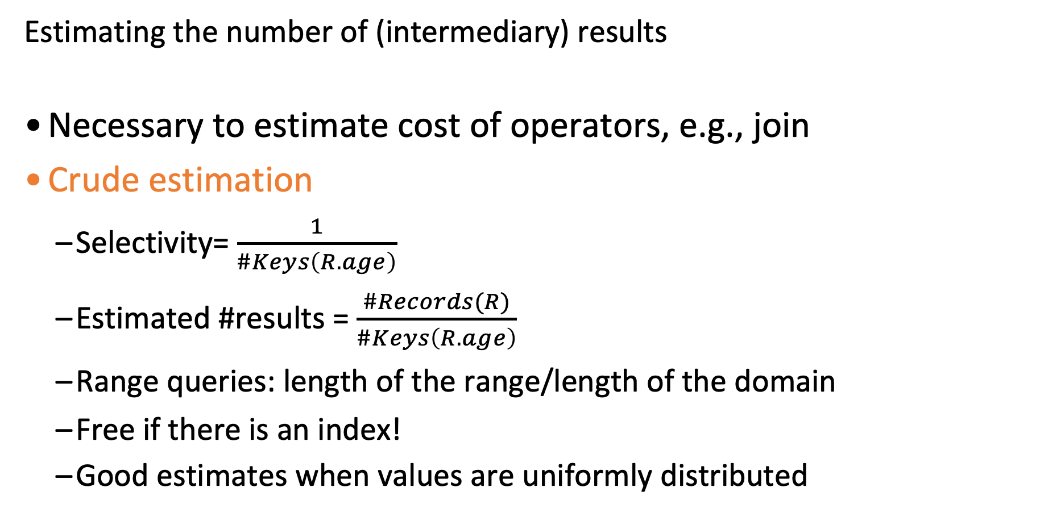
Selectivity estimates
Estimating the number of (intermediary) results
Necessary to estimate cost of operators, e.g., join
Crude estimation
Selectivity= $\frac{1}{\#Keys\left(R.age\right)}$
Estimated #results = $\frac{\#Records(R)}{\#Keys\left(R.age\right)}$
Range queries: length of the range/length of the domain
Free if there is an index!
Good estimates when values are uniformly distributed
SELECT * FROM R WHERE r.age=18
Number of distinct
values
Notes:
Let us consider a simple query which lists all the records from R with age=18. Now our goal is to estimate the selectivity of this filter predicate. Typically, it is estimated using meta data structures such as histograms, and other meta data information stored. For this equality predicate, the selectivity is estimated to be 1/distinct-values(age), using that we can get the total no. of tuples satisfying the predicate. As expected, this formula works when the age is uniformly distributed.
For range queries, the estimate becomes equal to length of the range by the length of the domain. Generally, histogram is used to compute the length of the range which is also an approximation. Again, the estimate is correct only if the data is uniformly distributed.
Due to changes in data, the meta data information is updated regularly inorder to make sure that the estimates are correct (in some cases, user needs to instruct the db to re-compute them!)
If there is an index for the age, then one can go though the index without having to access the data, and accurately estimate the selectivities. Going through the index is more expensive than computing from histograms, but could be worth the efforts for long running queries.
For these simple queries, even if there are errors in estimate, it should be okay, unless it changes the access path decision.

Slide 46
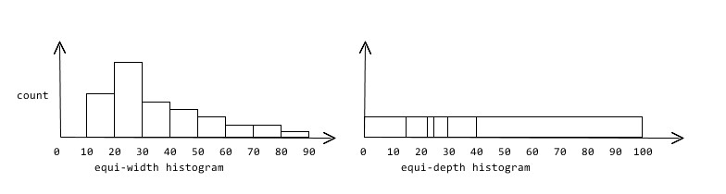
Selectivity estimates
Estimating the number of (intermediary) results
Histograms: Equi-width and Equi-depth
Higher cost to build and maintain, but better accuracy.
SELECT * FROM R WHERE r.age=18
Skew somewhere in [20-29]
Skew in 23
Accurate in [60-100]
Very inaccurate
in [40-100]
Notes:
Now, let us see how the different types of histograms used in DBMS, namely – equi width and equi depth. In equi width histograms, the entire range of the domain of age is divided into equal range values. For instance, if there are 10 buckets and the domain range of age is 0-100, then each bucket can have range [0,9], [10,19], and so on. For example, for r.age=18, we only need to use the count and #keys for the bucket where 18 falls into! for better accuracy. As can be seen, since there are less values in each bucket from [60,100], the accuracy of the estimate is better. But becomes lesser accurate for values in the range [20,29].
Equi depth histograms, as the name says make sure that every bucket maintains almost similar counts. Here the boundaries of the histogram are decided based on the similar count constraint. Once can see from the figure that there is a skew for value 23, and hence maintain a single bucket for it. Thus if a query falls in this range we can get accurate estimate. Also one can see, there is one bucket between 40 to 100. Hence, since this is a large range bucket, the estimates become inaccurate. Equi depth histogram, is harder to maintain as the boundaries need to shift with changes in data. Building is also hard as the data need to sorted.
Clearly, both equi-width and equi-depth have their benefits for different distributions. Generally, equi-depth are preferred but they are more expensive to build. Equi-depth histogram is used in PostgreSQL.

Slide 47
Join cardinality estimates
π_{sid}
How large
is the output
Required for cost estimation of each join
Reorder joins so that records are filtered as fast as possible!
⨝
⨝
T
σ_{bid=100}
σ_{rating>5}
R
S
Notes:
We will now use a similar approach to estimate the selectivity of a join. Again to get the cost of a join operator and hence total cost of a plan. Next, we will see a formula used for join size estimation.
These estimates help in getting good query plans. For instance, if we know the estimates, then we can then reorder joins to reduce the number of intermediary results as early in the tree as possible.

Slide 48
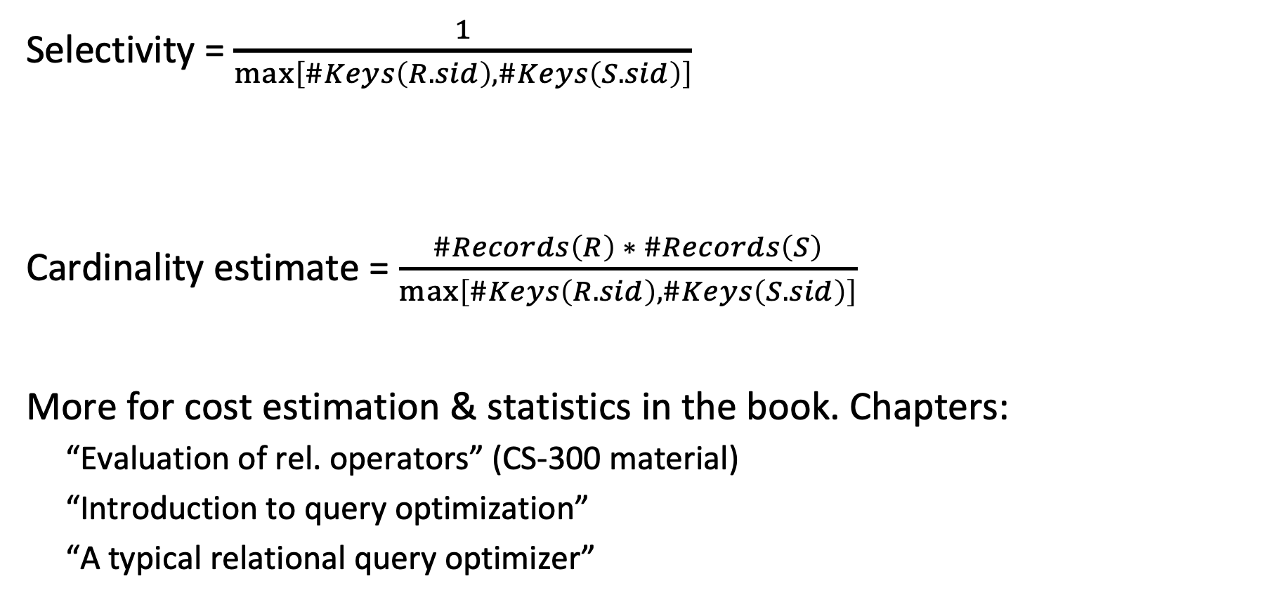
Join cardinality estimates
Selectivity = $\frac{1}{\max\left[\#Keys\left(R.sid\right),\#Keys\left(S.sid\right)\right]}$
Cardinality estimate = $\frac{\#Records\left(R\right) ∗ \#Records\left(S\right)}{\max\left[\#Keys\left(R.sid\right),\#Keys\left(S.sid\right)\right]}$
More for cost estimation & statistics in the book. Chapters:
“Evaluation of rel. operators” (CS-300 material)
“Introduction to query optimization”
“A typical relational query optimizer”
If unknown, use 10
Notes:
Lets now see we can estimate for joins. The selectivity estimate for a join between R.sid = S.sid is 1/max(distinctvalues(R.sid), distinctvalues(S.sid)). The distinct value count is typically maintained for every column of the database.
There are two assumptions made such as uniform data, and inclusion principle. Inclusion principle means that domain of join key overlap such that every key of one relation exist in the other relation. For instance, consider the scenario when keys does not intersect at all, then the assumption is completely violated. This results in actual join output being zero while the estimate is non-zero (way off!).

Slide 49
Outline
Introduction to query optimization
Relational algebra equivalences
Optimizers based on heuristics – INGRES
Optimizers based on heuristics & cost
Cost & selectivity estimation
Principle of optimality
System R

Slide 50
SYSTEM R Optimizer
IBM SYSTEM R
Seminal project from the 70s
Drastic influence on succeeding DBs!
High-level idea
Iterate over the possible plans
Order of operators, physical implementations of operators, access paths
Estimate cost of each plan
Return the cheapest to the user
Too many plans. Use heuristics
to reduce the search space
Pat Selinger
IBM Fellow,
Paradata,
Salesforce
Notes:
System R is a seminal work from IBM in late 70s. Prior to that people believed that a DBMS could never choose a query plan better than what a human could write.
Even now many assumptions about data distributions are still made today in practice to make the problem tractable. Along with even some of the concepts and design decisions are still used.
As mentioned before, System R is the first cost based optimizer. It uses a mix of heuristics and cost-based optimization. The high level idea is to generate all possible plans in a restricted plan search space. For instance, by considering only left deep plans. In this space, cost each plan and return the cheapest plan. It is typically expensive to consider all possible plans, so thus, it uses dynamic programming to very effectively prune the search space.

Slide 51
SYSTEM R Optimizer
Step 1: Break query up into blocks and generate the logical operators for each block.
Reduces complexity of each plan
Block: No nested queries, exactly one SELECT & FROM, and at most one WHERE, GROUP BY, HAVING
SELECT S.sid, MIN (R.day)
FROM Sailors S, Reserves R, Boats B
WHERE S.sid = R.sid AND R.bid = B.bid AND B.color = ‘red’
AND S.rating = (SELECT MAX (S2.rating) FROM Sailors S2)
GROUP BY S.sid
HAVING COUNT(*)>1
Notes:
Let us now see how System R generates query plans. First, it identifies the blocks of queries in the whole query. The block is defined as exactly one SELECT & FROM, and at most one WHERE, GROUP BY, HAVING clause. As an example, in the above query there are two blocks, one in green and the other in red. The queries in inside another query are called nested queries. The reason to break the query is for reducing the plan search space.

Slide 52
SYSTEM R Optimizer
Step 1: Break query up into blocks and generate the logical operators for each block.
Reduces complexity of each plan
Block: No nested queries, exactly one SELECT & FROM, and at most one WHERE, GROUP BY, HAVING
Nested Block:
SELECT MAX (S2.rating) FROM Sailors S2
SELECT S.sid, MIN (R.day)
FROM Sailors S, Reserves R, Boats B
WHERE S.sid = R.sid AND R.bid = B.bid AND B.color = ‘red’
AND S.rating = Reference to Nested Block
GROUP BY S.sid
HAVING COUNT(*)>1
Notes:
Each of these blocks are independently optimized. This is okay, if the inner query block is independent, i.e. it has no reference to a value obtained from a candidate tuple of the outer query block. On the other hand, if there is a dependence it is called as correlated query block.
In the correlated case, the inner query block need to be optimized for every value of the outer block which turns out to be expensive. Hence, it is always attempted to `unnest’ a query. For example,
Original Query: SELECT S.sname FROM Sailors S WHERE EXISTS (SELECT * FROM Reserves R WHERE R.bid=103 AND R.sid=S.sid)
Nested block to optimize: SELECT * FROM Reserves R WHERE R.bid=103 AND S.sid= outer value
Nested block is optimized independently, with the outer tuple considered as providing a selection condition. Outer block is optimized with the cost of `calling’ nested block computation taken into account.
Equivalent non-nested query: SELECT S.sname FROM Sailors S, Reserves R WHERE S.sid=R.sid AND R.bid=103
The unnested version of the query is typically optimized better.

Slide 53
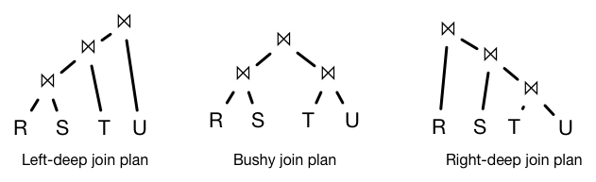
SYSTEM R Optimizer
Step 1: Break query up into blocks and detect the logical operators in each block.
Step 2: For each individual block:
For each logical operator, consider a set of physical operators & offered access paths.
Iteratively construct a “left-deep” tree that minimizes the estimated amount of work to execute the plan.
Why left-deep?
Notes:
Second step in the optimization process is to find the physical plan for each individual block. Try to decide on the physical implementation of each operator and on the access path. Iteratively build the plan bottom up using dynamic programming approach.
Additional heuristics to reduce plan space (besides the blocks) is to only consider left-deep plans!
Left-deep trees naturally transform to physical plans with pipelining, it is particularly good for hardware that was available back in 1980s since it frequently does not require writing the intermediary results to the disk!
Even today, ORACLE has a preference towards left-deep trees.

Slide 54
SYSTEM R Optimizer
Retrieve the names of artists that appear on Joy's mixtape
SELECT ARTIST.NAME FROM ARTIST, APPEARS, ALBUM
WHERE ARTIST.ID=APPEARS.ARTIST_ID AND APPEARS.ALBUM_ID=ALBUM.ID AND ALBUM.NAME=“Joy's Slag Remix” ORDER BY ARTIST.ID
ARTIST: Sequential scan
APPEARS: Sequential scan
ALBUM: Index lookup on name
Step #1: Choose the best access path to each table
ARTIST_ID | ALBUM_ID
FK | FK
ARTIST, APPEARS: No predicate in the WHERE clause
implies table scan
APPEARS
Q4
ID | NAME
Integer, PK | VARCHAR(32)
ARTIST
ALBUM: Index would help (assume it exists)
ALBUM
ID | NAME
Integer, PK | VARCHAR(32) UNIQUE
Notes:
Example with a single-block query which “Retrieve the names of people that appear on Joy's mixtape”. The first step is to choose the best access path for each of the three relations.
Since there is no predicate on the APPEARS or ARTIST, this means that all the tuples need to be accessed at the first step. Hence, sequential scan of these tables are preferred.
Assume that there is an index available on the name attribute of ALBUM table, and that the selectivity of this predicate is less, then it is best to use index scan as the access path for ALBUM table.

Slide 55
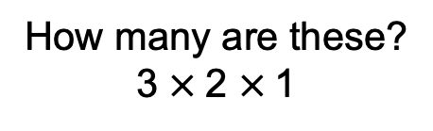
SYSTEM R Optimizer
Retrieve the names of artists that appear on Joy's mixtape
SELECT ARTIST.NAME FROM ARTIST, APPEARS, ALBUM
WHERE ARTIST.ID=APPEARS.ARTIST_ID AND APPEARS.ALBUM_ID=ALBUM.ID AND ALBUM.NAME=“Joy's Slag Remix” ORDER BY ARTIST.ID
ARTIST: Sequential scan
APPEARS: Sequential scan
ALBUM: Index lookup on name
All possible join orders
ARTIST ⨝ APPEARS ⨝ ALBUM APPEARS ⨝ ALBUM ⨝ ARTIST ALBUM ⨝ APPEARS ⨝ ARTIST … … …
Step #1: Choose the best access path to each table
Step #2: Enumerate all possible join orderings for tables
How many are these?
3 $×$2 $×$1
Notes:
Once the access path is fixed, next step is to decide on the join order and corresponding operator implementations. Since System R restricts the plan structures to left deep plans, the number of possible join orders is N! Many systems have removed this limitations.

Slide 56
SYSTEM R Optimizer
Retrieve the names of artists that appear on Joy's mixtape
SELECT ARTIST.NAME FROM ARTIST, APPEARS, ALBUM
WHERE ARTIST.ID=APPEARS.ARTIST_ID AND APPEARS.ALBUM_ID=ALBUM.ID AND ALBUM.NAME=“Joy's Slag Remix” ORDER BY ARTIST.ID
ARTIST: Sequential scan
APPEARS: Sequential scan
ALBUM: Index lookup on name
keep cheapest access methods
+
those producing an interesting order*
Step #1: Choose the best access path to each table
possible join orders?
ARTIST ⨝ APPEARS ⨝ ALBUM APPEARS ⨝ ALBUM ⨝ ARTIST ALBUM ⨝ APPEARS ⨝ ARTIST … … …
Step #2: Enumerate all possible join orderings for tables
Step #3: Determine the join ordering with the lowest cost
*tuple ordering as needed by a group-by, an order-by, or a join
Notes:
Then, for each join order, trying out all possible join algorithms, gives different equivalent plans. Then one need to cost each of these alternate plans to find the best plan for the query.

Slide 57
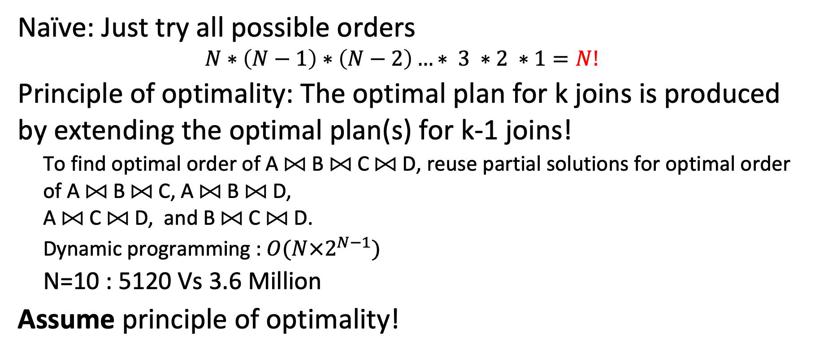
Join ordering
Scales BADLY with #joins N
Naïve: Just try all possible orders
$$N∗\left(N−1\right)∗\left(N−2\right)…∗ 3 ∗2 ∗1=N!$$
Principle of optimality: The optimal plan for k joins is produced by extending the optimal plan(s) for k-1 joins!
To find optimal order of A ⨝ B ⨝ C ⨝ D, reuse partial solutions for optimal order of A ⨝ B ⨝ C, A ⨝ B ⨝ D, A ⨝ C ⨝ D, and B ⨝ C ⨝ D.
Dynamic programming :$O(N×2^{N−1})$
N=10 : 5120 Vs 3.6 Million
Assume principle of optimality!
Still expensive but feasible
Notes:
Even though we restricted ourselves to left-deep, the number of join orders is N factorial. This is becomes very expensive as N increases. For instance, if N=10, then different possible join orders are 3.6 million. This is just the operator ordering considering different operator implementations, the search space increases further.
In order to reduce this search space, System R uses the principle of optimality on the basis of dynamic programming. In general, principle of sub-optimality says that the subsolutions of an optimal solution of the problem are themselves optimal solutions for their subproblems. Consider the shortest path problem between location A and location E. If the optimal solution is A – B – C – D – E, then A – B – C is shortest path between A and C, and C – D – E is shortest path between C and E.
Using this principle, the final plan is constructed bottom-up iteratively. In step K, the optimal plans for joining k relations is produced. This is done by considering the optimal plan of k-1 joins, and extending it by adding a relation to it. This results in complexity of $O\left(N×2^{N−1}\right),$ which is around 5120 for N=10, and is much lesser than 3.6 millions.

Slide 58
Principle of optimality – Getting A⨝B ⨝ C ⨝D
….
A⨝B⨝D⨝C
….
Cost 1=70
A⨝B⨝C
A⨝B⨝D
A⨝C⨝ D
B⨝C⨝ D
A⨝B
A⨝C
A⨝D
B⨝C
B⨝D
C⨝D
A
B
C
D
Notes:
Let us see how using principle of optimality, we can find the best plan with an example of joining four relations A, B, C and D.
The algorithm run in N passes if N relations joined. Following is its description:
Pass 1: Find best 1-relation plan for each relation. 
Essentially, choose the best access path for each relation.
Pass 2: Find best way to join result of each 1-relation plan (as outer) to another relation. (All 2-relation plans.) 
Pass N: Find best way to join result of a (N-1)-relation plan (as outer) to the N’th relation. (All N-relation plans.)
Finding the best access path for each of the relations: A, B, C and D.
Look at pair of the four relations and pick the best join algorithm for each of them, and freeze the choice (for each of them).
Similarly for 3-relation joins.
The ABDC join costs 70 units

Slide 59
Principle of optimality – Getting A⨝B⨝D
Choose the cheapest path to create A⨝B⨝D, and consider it fixed for higher levels!
….
A⨝D⨝B⨝C
….
Cost 2=100
A⨝B⨝C
A⨝B⨝D
A⨝C⨝ D
B⨝C⨝ D
A⨝B
A⨝C
A⨝D
B⨝C
B⨝D
C⨝D
A
B
C
D
Notes:
There is another plan ADBC which costs 100 units.

Slide 60
Back to our running example…
HashJoin cost=10
SM Join cost=20
NL Join=100
ARTIST⨝APPEARS
ALBUM
ARTIST
APPEARS
ALBUM
ARTIST⨝APPEARS⨝ALBUM
ALBUM⨝APPEARS
ARTIST
HashJoin cost=10
SM Join cost=20
NL Join=100
SELECT ARTIST.NAME FROM ARTIST, APPEARS, ALBUM
WHERE ARTIST.ID=APPEARS.ARTIST_ID AND APPEARS.ALBUM_ID=ALBUM.ID AND ALBUM.NAME=“Joy's Slag Remix” ORDER BY ARTIST.ID
…
Notes:
Let us see the trace of the algorithm using our previously mentioned example. Recall it has three tables and that we had fixed the access paths for each of them.
ALBUM – Index scan
ARTIST, APPEARS – Sequential Scan
Left most box represents that no table is joined which is the initial state, and right most box captures the final goal with all tables joined.
The next step is to look at all possible two-relations join. For simplicity we consider two of them -- ARTIST join APPEARS, and ALBUM join APPEARS. There are three possible join algorithms for each of them, and we cost each of them for both the joins.

Slide 61
Back to our running example…
HashJoin cost=10
SM Join cost=20
NL Join=100
ARTIST⨝APPEARS
ALBUM
ARTIST
APPEARS
ALBUM
ARTIST⨝APPEARS⨝ALBUM
ALBUM⨝APPEARS
ARTIST
HashJoin cost=10
SM Join cost=20
NL Join=100
SELECT ARTIST.NAME FROM ARTIST, APPEARS, ALBUM
WHERE ARTIST.ID=APPEARS.ARTIST_ID AND APPEARS.ALBUM_ID=ALBUM.ID AND ALBUM.NAME=“Joy's Slag Remix” ORDER BY ARTIST.ID
…
Notes:
The above figure shows that Hashjoin is best for both the joins, and the decision is fixed for them.
Reading list: Read example at section 3 from here: https://web.stanford.edu/class/cs345d-01/rl/chaudhuri98.pdf

Slide 62
Back to our running example…
HashJoin cost=10
ARTIST⨝APPEARS
ALBUM
HashJoin cost=35
SM Join cost=55
NL Join=80
ARTIST
APPEARS
ALBUM
ARTIST⨝APPEARS⨝ALBUM
HashJoin cost=30
SM Join cost=20
NL Join=100
ALBUM⨝APPEARS
ARTIST
HashJoin cost=10
SELECT ARTIST.NAME FROM ARTIST, APPEARS, ALBUM
WHERE ARTIST.ID=APPEARS.ARTIST_ID AND APPEARS.ALBUM_ID=ALBUM.ID AND ALBUM.NAME=“Joy's Slag Remix” ORDER BY ARTIST.ID
…
Notes:
Again from ALL POSSIBLE two-join relations, we explore how to get our target 3-relation join. For example, from ARTIST⨝APPEARS join we need to add ALBUM relation. It can be joined using any of the three join algorithms.
Similar argument apply for the other 2-relation join.

Slide 63
Back to our running example…
HashJoin cost=10
ARTIST⨝APPEARS
ALBUM
HashJoin cost=35
SM Join cost=55
NL Join=80
ARTIST
APPEARS
ALBUM
ARTIST⨝APPEARS⨝ALBUM
HashJoin cost=30
SM Join cost=20
NL Join=100
ALBUM⨝APPEARS
ARTIST
HashJoin cost=10
SELECT ARTIST.NAME FROM ARTIST, APPEARS, ALBUM
WHERE ARTIST.ID=APPEARS.ARTIST_ID AND APPEARS.ALBUM_ID=ALBUM.ID AND ALBUM.NAME=“Joy's Slag Remix” ORDER BY ARTIST.ID
…
Notes:
The above figure shows that Hashjoin is best for one, while SM join is best for the other. All other possibilities are discarded.

Slide 64
Back to our running example…
HashJoin cost=10
ARTIST⨝APPEARS
ALBUM
HashJoin cost=35
ARTIST
APPEARS
ALBUM
ARTIST⨝APPEARS⨝ALBUM
SM Join cost=20
ALBUM⨝APPEARS
ARTIST
HashJoin cost=10
SELECT ARTIST.NAME FROM ARTIST, APPEARS, ALBUM
WHERE ARTIST.ID=APPEARS.ARTIST_ID AND APPEARS.ALBUM_ID=ALBUM.ID AND ALBUM.NAME=“Joy's Slag Remix” ORDER BY ARTIST.ID
…

Slide 65
Back to our running example…
HashJoin cost=10
ARTIST⨝APPEARS
ALBUM
HashJoin cost=35
SUM=45
ARTIST
APPEARS
ALBUM
ARTIST⨝APPEARS⨝ALBUM
SUM=30
SM Join cost=20
ALBUM⨝APPEARS
ARTIST
HashJoin cost=10
SELECT ARTIST.NAME FROM ARTIST, APPEARS, ALBUM
WHERE ARTIST.ID=APPEARS.ARTIST_ID AND APPEARS.ALBUM_ID=ALBUM.ID AND ALBUM.NAME=“Joy's Slag Remix” ORDER BY ARTIST.ID
…
Notes:
ARTIST⨝APPEARS⨝ALBUM has cost 45, while ALBUM⨝APPEARS⨝ARTIST has cost 20.

Slide 66
Back to our running example…
ARTIST
APPEARS
ALBUM
ARTIST⨝APPEARS⨝ALBUM
SUM=30
ALBUM⨝APPEARS
ARTIST
HashJoin cost=10
SM Join cost=20
Constructed in parallel:
Logical plan (join order)
Physical plan (join implementation)
Notes:
Hence, the ALBUM⨝APPEARS⨝ARTIST is chosen as the best plan with the corresponding choice of join algorithms and access paths. This is an over simplification of how things work but this is the general idea of how System R works. This design is incorporated in PostgreSQL, MySQL, Oracle, etc.
The non-overlapping paths in the plan generation can be parallelized for faster plan generation.
There is another important property called as interesting orders. Let us now consider a query that represents the join among (R1 , R2) with the predicates R1.a = R2.a, and say there is an order-by clause on a. Let us also assume that the cost joining (R1, R2) are x and y for nested-loop and sort-merge join, respectively and that x < y. In such a case, sort-merge might be a better choice as the ordering of query output comes for free, which is not the case in NL join. These choices called as interesting orders which are also maintained in practice.

Slide 67
What did we use?
Logical & Physical statistics
size of each record, #records, #distinct values in column, #data pages, #pages in index, …
Selectivity estimates
Histograms (or other distribution assumptions)
Formulas for selectivity estimates: assumption of selectivity independence!
Formulas to estimate IO costs (possibly also CPU) per operator
Access methods (index or scan), natural orders (e.g., primary key, …)
Order of output data stream
The principle of optimality
Notes:
For choosing the best plan, the optimizer also relies on logical and physical statistics. Logical statistics concern the statistics related to tables or records. It has information such as no. of records, size of each record, no. of distinct values in each column, most common values for each columns, etc. It also varies with different systems.
Physical statistics concern the actual storage, in terms of the no. of data pages required to store a table. Also no. of pages used by each index.
.
For selectivity estimates, histograms are used for computing the estimates. Also typically, assumption of selectivity independence: Consider, e.g., that we have two selections (age<10 & height >1.80 m). These are typically mutually exclusive. But database doesn’t know this! it will consider selectivity of each of them only! Histograms (1-d) will be used to compute selectivity, and the two selectivities will be multiplied!
The IO cost are calculated based on the IO cost of each operator and then aggregated them.

Slide 68
Principle of optimality Revisited!
Principle of optimality may lead to suboptimal plans
E.g., order not considered
Additional cost at the end – avoided by sort merge join!
Relaxed principle of optimality
Consider order-by clause! A plan is compared with all other plans that produce the same order
SELECT ARTIST.NAME FROM ARTIST, APPEARS, ALBUM
WHERE ARTIST.ID=APPEARS.ARTIST_ID AND APPEARS.ALBUM_ID=ALBUM.ID AND ALBUM.NAME=“Joy's Slag Remix” ORDER BY ARTIST.ID
Notes:
Next question, does principle of optimality always work? In the sense, are there scenarios where we can miss optimal plans.
Ans: yes! When there is an order-by clause in the query, for instance, artist.id in this case. Then, we need to have an extra sort operation at the end of the plan which incurs cost depending on the amount tuples to be sorted. However, the extra sort operation is not required when the ARTIST.ID=APPEARS.ARTIST_ID join is joined using sort-merge join, the output of which would be sorted based on artist.id. Thus, a locally optimal choice may not be globally optimal choice.
Thus focusing only on joins is not always good. Hence, we need to check the rest of the query plan to decide the operator implementation.
Thus, some system compare all the plans that produce the same order of results.

Slide 69
Interesting orders
A tuple order is interesting order if that order is specified in:
Group By clause
Order By clause
Choose plans that produce the correct order, e.g.,
Sort-merge join instead of NL join
Later generalized to include any physical properties!
Will cause an additional sorting
Notes:
In order to address the issue, system incorporate what is called as an interesting orders. A tuple order is interesting order if that order is specified in a group by or order by clause. Order by is understandable, but why group by?
As explained before, we might choose sort-merge instead of NL join based on the interesting order. Generally, optimizers keep two plans at every step in the System R algorithm,: a) best interesting order plan, b) best plan (with considering interesting order). In this case, for the final choice, the decision is taken based cost(best interesting ordered plan) vs cost(best plan) + cost of sorting at the end.
Not just sorting, other physical properties can be part of the interesting order. E.g,. where it data stored, whether it is partitioned or not, etc.

Slide 70
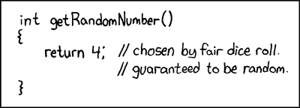
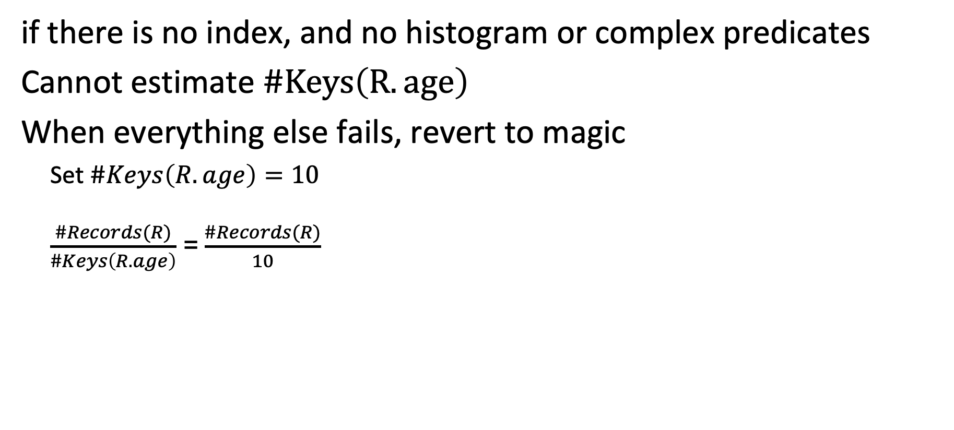
Selectivity estimates, revisited
if there is no index, and no histogram or complex predicates
Cannot estimate $\#Keys\left(R.age\right)$
When everything else fails, revert to magic
Set $\#Keys\left(R.age\right)=10$ $\frac{\#Records(R)}{\#Keys\left(R.age\right)}$ = $\frac{\#Records(R)}{10}$
Source: https://xkcd.com/221/
Notes:
We saw that selectivities are computed using meta structures such as histograms, and index. But there are situations wherein histograms are not maintained for all columns, also there are scenarios wherein the histogram building time may not be available.
Further, index are generally maintained on primary and foreign keys, and not on all columns. This is because, index consumes a lot of space and is very hard to maintain in case of updates (along with data, even indexes have to updated which incurs random read and writes).
The other main issue is the complex predicates. The optimizers are very sensitive, even predicates like sqrt(age) = 5, are also hard for optimizers (at least some time before). Similar issues exist with string predicates, such as name like ‘%John%’. Another major issue is User defined functions, which are generally treated as black boxes and not optimized well. They find it hard to get the estimates right.
In presence of such scenarios, the optimizer reverts to magic numbers such 1/10 selectivity.

Slide 71

Anecdote
Guy Lohman
“Is Query Optimization a “Solved” Problem?”
The root of all evil, the Achilles Heel of query optimization, is the estimation of the size of intermediate results, known as cardinalities. Everything in cost estimation depends upon how many rows will be processed, so the entire cost model is predicated upon the cardinality model. In my experience, the cost model may introduce errors of at most 30% for a given cardinality, but the cardinality model can quite easily introduce errors of many orders of magnitude! I’ll give a real-world example in a moment. With such errors, the wonder isn’t “Why did the optimizer pick a bad plan?” Rather, the wonder is “Why would the optimizer ever pick a decent plan?”
Notes:
To get a feel of the current situation of query optimizers. Here is an anecdote from Dr. Guy Lohman, a chief architect of IBM DB2. He writes a blog in 2014, and says that the above unlined statement.

Slide 72
Summary of System R optimizer
Both heuristics and cost
Efficient and usually derives reasonable plans
Relies on
Principle of optimality
Interesting orders
System R was never commercialized but was hugely influential!

Slide 73
Heuristics + cost-based optimizer
Advantages:
→ Usually finds a reasonable plan without having to perform an exhaustive search.
→ Order of results also considered!
Disadvantages:
→ Depends on heuristics: Left-deep join trees are not always optimal (particularly for modern hardware)
→ Space exploration only considers joins
Notes:
Problems:
At the heuristics part, we need to apply all these heuristics (similar to INGRES, e.g., pushing down predicates and selections, checking equivalences…) BEFORE being able to even consider join orderings. If these heuristics work well, then great. If not, then too bad!
What if two queries are executed at the same time and the first one occupies a lot of memory?
Space exploration only considers joins. All other choices decided by the heuristics
Left deep joins used to reduce space of the plan. They were reasonable many years ago, and they were preferred in order to reduce IO (pipelining) but are they reasonable now?

Slide 74
AI/ML for database systems
AI captures non-obvious patterns/topologies
Can help multi-objective optimization
Efficiently explore large design spaces
Adaptive optimization
User workload affinity
But: overhead can overpower benefits
Use case: dynamic query optimization
Notes:
Eleni:
A few people said that they did not get what “accelerates real-time” mean. Bellow is how I think this slide should be:
To connect this nicely to the outline:
In this slide:
I’d first highlight what AI is good at: (a) capturing complex relations (AI excels at identifying non-obvious patterns and relationships → very relevant for the topic of the talk, aka how to navigate today’s complex topologies. These complex topologies can be overwhelming for a traditional optimizer) (b) multi-objective optimization (again necessary for complex topologies and different types of resources) (c) Exploring large design spaces (d) Adaptive optimization
Then mention some examples (as you have currently on this slide)
Finally, say that we need to find the right AI approach to avoid the overhead from AI overpower the benefits
The next slides are about Roulette. Transition: You will focus on Roulette as it solves a problem that ticks all the boxes for what AI is good at ((a) – (d)) and also our solution shows the importance of choosing the right AI method
(Also, removed ”Generative” as what you describe here is not relevant only for GenAI but other types of AI as well. Also Roulette which follows does not use GenAI)

Slide 75
The Shared Query Execution Dilemma
Q1: … WHERE R.a=S.a and R.b=U.b and R.c=T.c
[Sioulas SIGMOD21]
Q2: … WHERE R.a=S.a and R.b=U.b and S.d=V.d
Optimization
⨝
⨝
Shared
⨝
U
⨝
U
⨝
Shared
⨝
T
V
⨝
⨝
Sharing benefit
R
S
R
S
Batch
Heuristics can detect some opportunities fast
Optimization can choose best opportunities at high cost
Too much and too little optimization hurt performance!
All-or-nothing exploration sacrifices scalability or performance
Notes:
To increase response times sublinearly, we need to do less extra work with each incoming query. To do that, we need to eliminate common computations across queries. This is work-sharing!
The important problem however, as queries themselves are declarative, is detecting these common computations.
Consider the example of two queries, Q1 and Q2 …
Now, the most common approach to share work between these two queries is find matching sub-plans. Both plans here have R JOIN S so we can exploit that fact: we create a common global plan that evaluates both queries by computing R JOIN S first then send the results with the two queries.
However, there are other alternatives for sharing. For example, by reordering joins with U, we can expose a larger common sub-plan, R JOIN S JOIN U, and therefore we can potentially share a greater part of the work. This is a more eager approach for sharing!
Now, which of the two approaches is better depends on the underlying data and needs to be decided through cost-based optimization. Yet, sharing-aware cost-based optimization has very high complexity and cannot scale to large query counts. We verified this fact for the previous page’s workload: a state-of-the-art sharing-aware optimizer took an order of magnitude more time for 11 queries than simply executing them and for 12 queries, we found problem instances where it hit an 1-hour timeout.
So, in maximizing our speedup against query at a time execution, he hit up against a wall! And the only practical way to avoid the wall is use greedy heuristics for choosing sharing opportunities fast. So, either we risk missing the best opportunities or we lose scalability.
Paper: Scalable multi-query execution using reinforcement learning, SIGMOD’21 (Roulette)

Slide 76








RL-enabled workload-conscious sharing
[Sioulas et al.,SIGMOD’21]
Optimize
Execute
Optimize
Execute
Optimize
Execute
…
…
Overlap of intermediate results is runtime info
Heuristic-based planning → missed opportunities
Split $R_{k}$
Split $R_{k+1}$
Split $R_{k+2}$
Episode k
Episode k+1
Episode k+2
Promising
Optimize
Execute
⨝
⨝
⨝
⨝
⨝
⨝
⨝
⨝
⨝
⨝
⨝
T
⨝
⨝
⨝
⨝
U
U
T
U
V
U
⨝
V
⨝
V
⨝
V
⨝
⨝
⨝
⨝
⨝
S
T
T
U
T
V
U
U
Sub-optimal
S
S
U
S
$$R_{k+3}$$
S
R_{k+2}
$$R$$
$$R_{k+1}$$
$$R_{k}$$
Global Plans
Executor
Learn more and better sharing opportunities
Notes:
So, instead of using an optimize-then-execute approach, we make sharing a runtime decision with JIT information. We break runtime into episodes, in which we re-optimize and execute queries. [animation] Through trial and error, we try many sharing opportunities, learn what to share from them, and make better accurate decisions. [animation] Eventually, our trials converge to the most efficient decisions that maximize throughput. For example, after trying query plans that focus on efficient plans for individual queries, we conclude that it’s best to choose a sub-optimal join order that maximizes sharing. We build the RouLette engine, which we presented in SIGMOD 2021, and which can accelerate query batches by progressively exploring sharing opportunities

Slide 77
Reading material
COW Book chapters 13 and 14 or Database System Concepts chapter 16

